Slide 1
FinOMOP
Data governance description of the three university hospital OMOP databases (Helsinki, Tampere, Turku)

Slide 2
Tampere University Hospital: Governance of the patient data
Mapping is done by the Clinical Informatics Team in the hospital.
Development of the OMOP data base and ETL by Productivity Leap, a Finnish SME trained by EHDEN.
Individual data from different source systems
is linked using the social security number.
All the operative
patient IT systems
Hospital data lake
Dg
Med
Data Permit granted
SQL
SQL
SQL
Lab
Staging
Raw Data
Business dv
Research area
Rad
Data secured and audited
analysis environment
(Atlas, R, SPSS, Python etc)
Proc
OMOP-mapping
OMOP-ETL
Path
Release of
Anonymous results
Terap
SQL
SQL
SQL
Gen
Master Data
OMOP DB
OMOP Extract
QoL
Research and OMOP data bases are updated regularly.

Slide 3
Turku University Hospital*: Governance of the patient data
*Hospital District of Southwest Finland (HDSF)
Development/mapping of the OMOP data base and the ETL was done by Auria Clinical Informatics (ACI). Vocabulary mappings together with the other FinOMOP members.
Individual data from different source systems
is linked using the social security number.
All the operative
patient IT systems
Hospital data lake
Dg
Med
Data Permit granted
SQL
SQL
SQL
Lab
Staging
Raw
Business dv
Research area
Rad
Data secured and audited
analysis environment
(Atlas, R, SPSS, Python etc)
Proc
OMOP-mapping
OMOP-ETL
Path
Release of
anonymous results
Terap
SQL
SQL
Gen
Analytical DB
OMOP DB
QoL
Analytical DB is updated daily and OMOP data base quarterly or when needed.

Slide 4
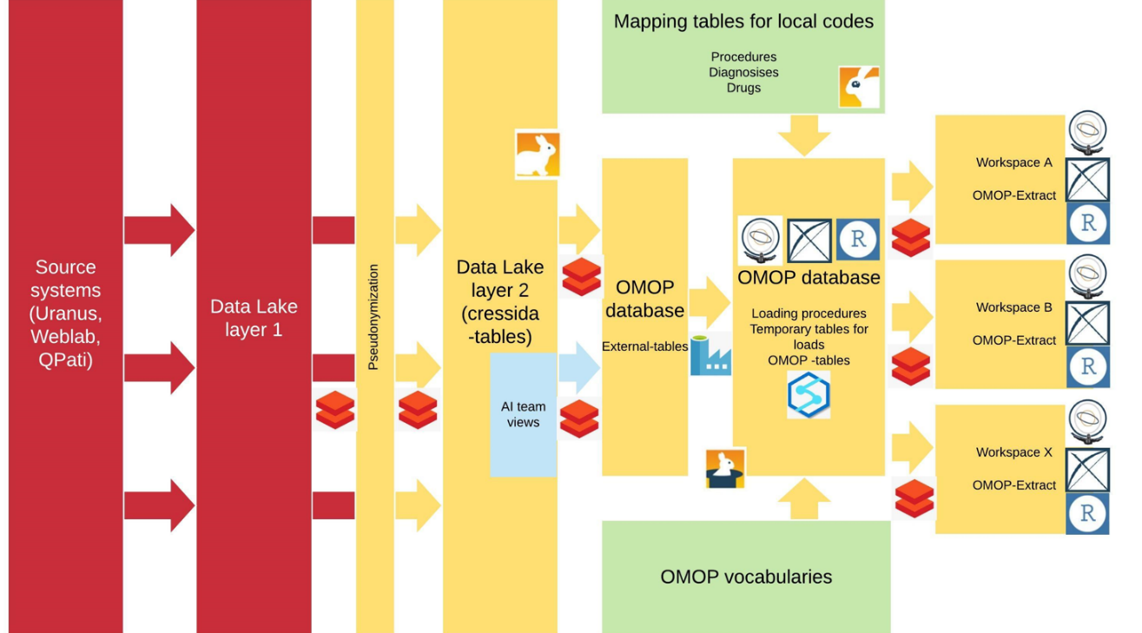
Helsinki University Hospital: Governance of the patient data
EHR (Apotti/Epic)
Imaging
Laboratory
Pathology
Genomics
Health Village
Operative/Finance

